Slide 1
Policy Matters Ohio
The State of
Working Ohio
2011
Amy Hanauer, Executive Director
216-361-9801
ahanauer@policymattersohio.og
www.policymattersohio.org

Slide 2
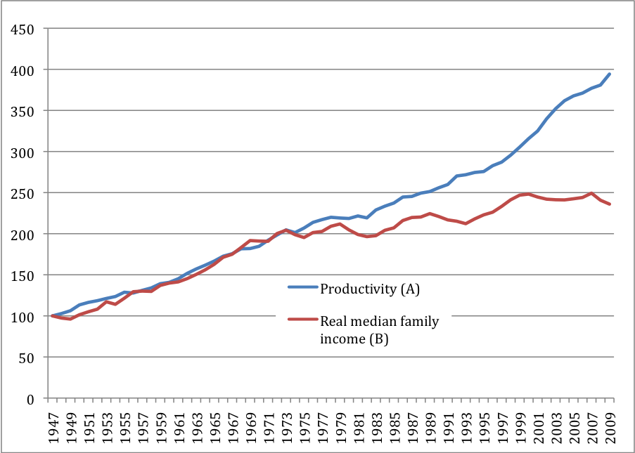
Policy Matters Ohio
Productivity and Median Family Income in the U.S., 1947-2009
www.policymattersohio.org
Notes:
Unshared prosperity: Between 1940 and 1979, U.S. income grew enough to have every American earn $28,749 more. The richest 10 percent got 28 percent of that increase and the bottom 90 percent shared the other 72 percent. In contrast, between 1979 and 2008, U.S. income grew enough for a $10,401 boost to each American, but every penny went to the richest 10 percent. Income for the bottom 90 percent declined over this period.
Our economy is still growing. In Figure 1 below, the blue line shows productivity growth, which has gone steadily upward since 1947. The red line shows inflation-adjusted median family income growth, which also grew steadily at the same pace as productivity, from 1947 to the mid 1970s. Both productivity and median family income approximately doubled between 1947 and 1979. Unfortunately, about 35 years ago the two lines began to diverge, with productivity continuing to gain steadily and median family income stagnating. From 1979 to 2009 productivity almost doubled again, growing by 79.9 percent. Family income over this period, however, grew by only 11.4 percent at the median and much of that growth was due to more family members entering the workforce, as opposed to greater compensation for each working family member. The benefits of increased productivity over the last 35 years have not gone to the middle-class families who helped create that productivity growth.

Slide 3
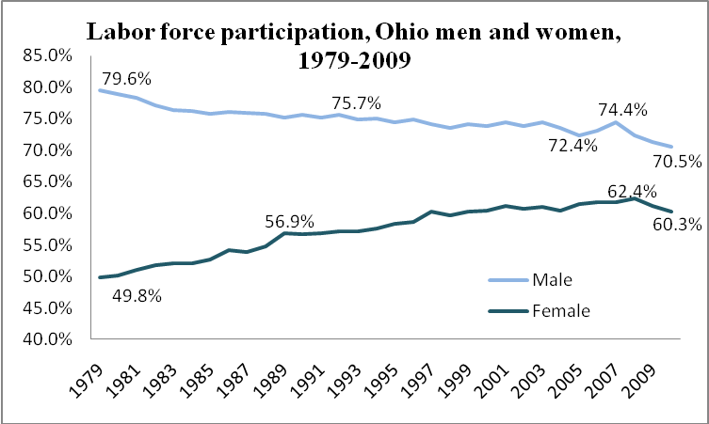
Policy Matters Ohio
www.policymattersohio.org
Notes:
Male Labor Force Participation lowest in more than 60 years of record keeping
Women’s LFP has been declining for last couple years, after decades of steady growth

Slide 4
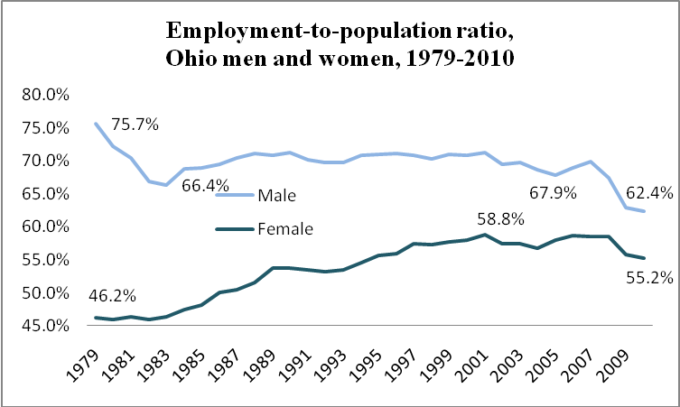
Policy Matters Ohio
www.policymattersohio.org
Notes:
Male employment lowest in more than 60 years of keeping track, four straight years of decline. Leaving people out.
Women’s down from peak

Slide 5
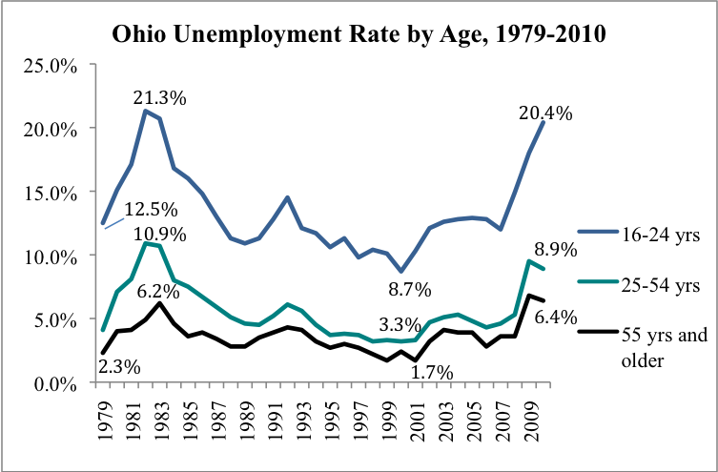
Policy Matters Ohio
www.policymattersohio.org
Notes:
Today’s young adults are trying to break into the labor market at the most inhospitable time in recent history, and they are often finding the entry ramp blocked. A staggering 20.4 percent of 16-24 year olds were unable to find work in 2010. In contrast to older age groups, this rate was slightly worse than in 2009. This hostile start to careers is likely to set many members of this generation permanently behind their elders in job security and quality. The job market for young adults has not been this bad since the recession of the early 1980s. The oldest workers face the lowest unemployment levels, at 6.4 percent, but it is worth noting that this unemployment rate for workers over age 55 is higher than at any time we’ve tracked, including that of the early 1980s recession. Figure 10 shows unemployment rates by age for working-age adults.

Slide 6
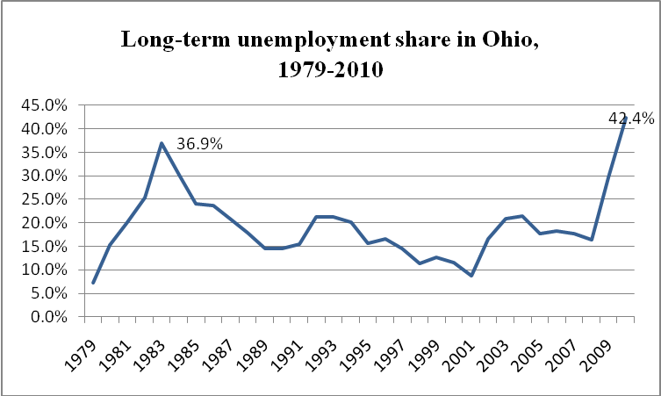
Policy Matters Ohio
www.policymattersohio.org

Slide 7
Policy Matters Ohio
Table 4
Median Wage by State by Year in 2010 Dollars, for U.S. and States with Wage Decline Over Past Decade
 | 1980 | 1990 | 2000 | 2010 | Change 80-90 | Change 90-00 | Change 00-10
US | $14.59 | $14.65 | $15.49 | $16.00 | $0.06 | $0.84 | $0.51
Ohio | $15.24 | $14.87 | $16.02 | $15.16 | -$0.37 | $1.15 | -$0.86
Tennessee | $12.58 | $12.42 | $14.53 | $13.80 | -$0.16 | $2.11 | -$0.73
Michigan | $16.66 | $15.43 | $16.60 | $15.90 | -$1.23 | $1.17 | -$0.70
Alaska | $23.32 | $20.21 | $18.42 | $17.75 | -$3.11 | -$1.79 | -$0.67
Minnesota | $14.65 | $15.09 | $18.17 | $17.54 | $0.44 | $3.08 | -$0.63
Missouri | $13.84 | $13.40 | $15.77 | $15.14 | -$0.44 | $2.37 | -$0.63
Illinois | $16.36 | $16.03 | $16.51 | $16.21 | -$0.33 | $0.48 | -$0.30
South Carolina | $12.06 | $12.90 | $15.14 | $14.86 | $0.84 | $2.24 | -$0.28
Indiana | $14.44 | $13.42 | $15.14 | $14.91 | -$1.02 | $1.72 | -$0.23
Iowa | $14.25 | $13.35 | $15.06 | $15.02 | -$0.90 | $1.71 | -$0.04
www.policymattersohio.org

Slide 8
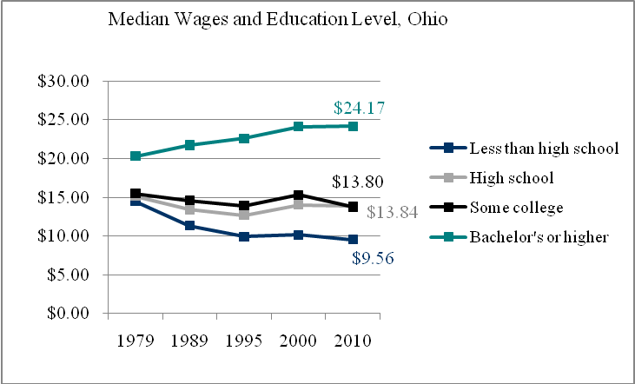
Policy Matters Ohio
www.policymattersohio.org

Slide 9
Policy Matters Ohio
Conclusion and Recommendations
Federal…
Invest in weatherization of schools and other public buildings
Invest in early childhood education
Provide fiscal relief to the states
Take steps to strengthen domestic manufacturing
www.policymattersohio.org

Slide 10
Policy Matters Ohio
Conclusion and Recommendations
State…
Employ workers directly in razing dilapidated housing, upgrading environmentally hazardous buildings, cleaning toxic algae, energy efficiency retrofits, early education, and preventive public health services
Restore the 50 percent cut to the local government fund
Restore the funding that was cut from local school districts in the next biennium which will result in layoffs of teachers, aides, librarians and more
www.policymattersohio.org

Slide 11
Policy Matters Ohio
….research for a more prosperous, equitable, sustainable, and inclusive Ohio
www.policymattersohio.org
Policy Matters
www.policymattersohio.org

